Slide 1
Creating & Promoting Excellence through Middle Leadership
Geoff Barton
King Edward VI School, Suffolk
Download this presentation at www.geoffbarton.co.uk

Slide 2
Gaining Ground

Slide 3
☑
☒
Notes:
What it is and what it could be
What it isn’t and what it shouldn’t be

Slide 4
☒
Notes:
As a GG partner school, here’s what I think it isn’t …

Slide 5
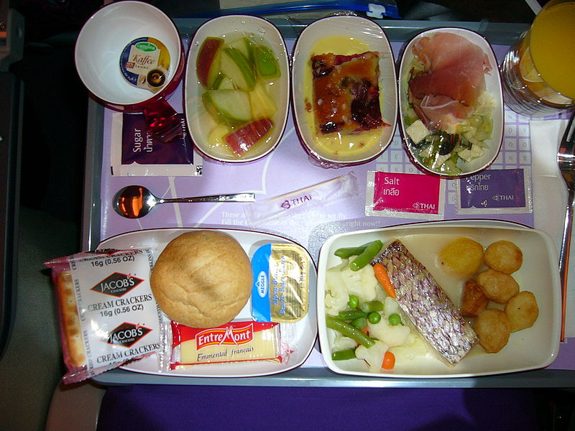

Slide 6
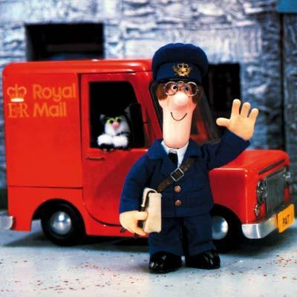

Slide 7
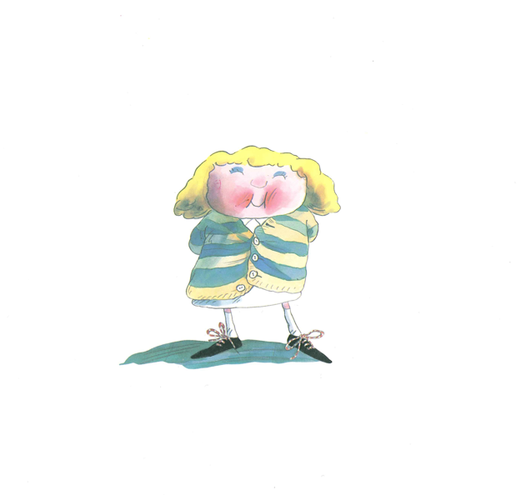
Genuine Partnership

Slide 9
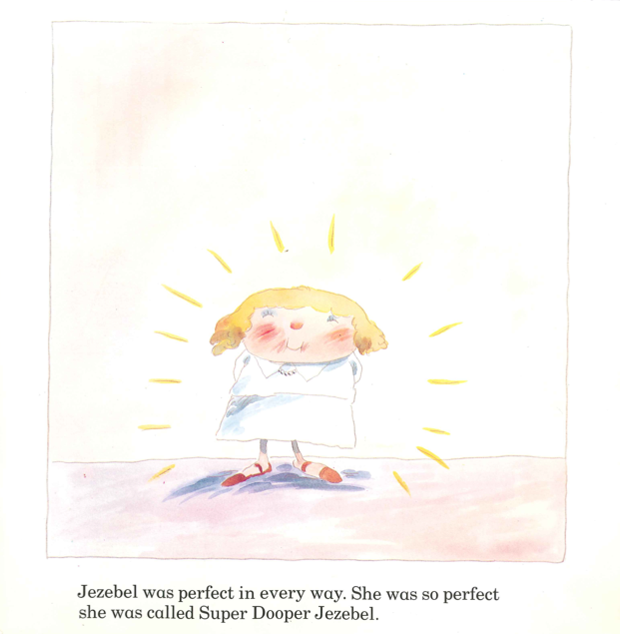

Slide 10
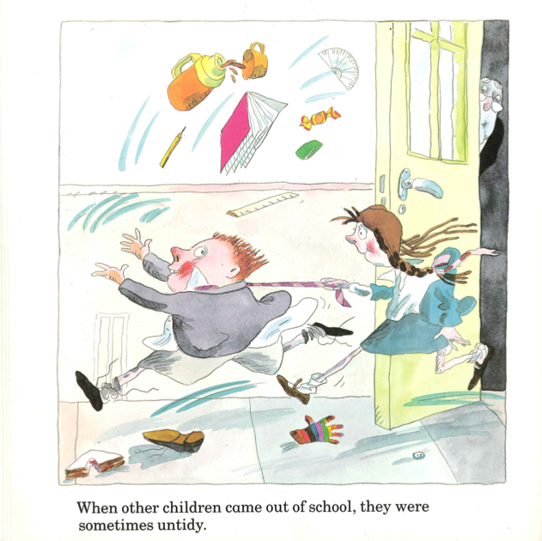

Slide 11
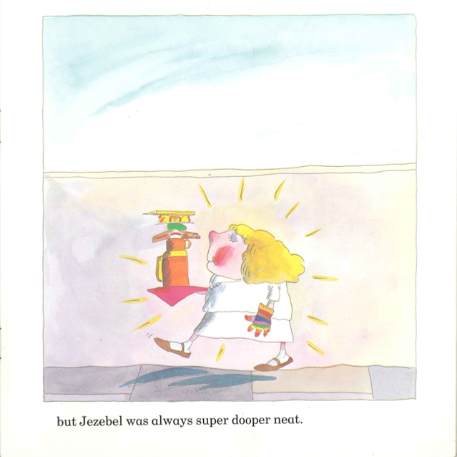

Slide 12
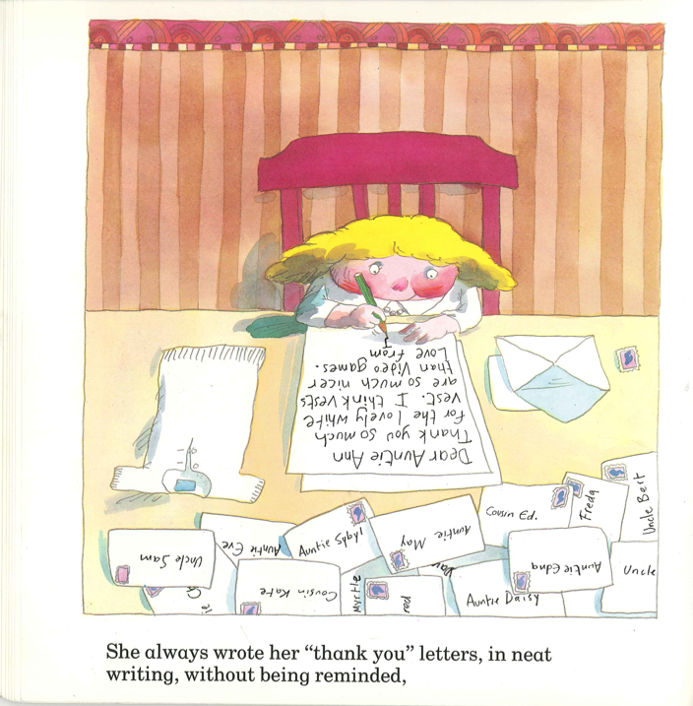

Slide 13
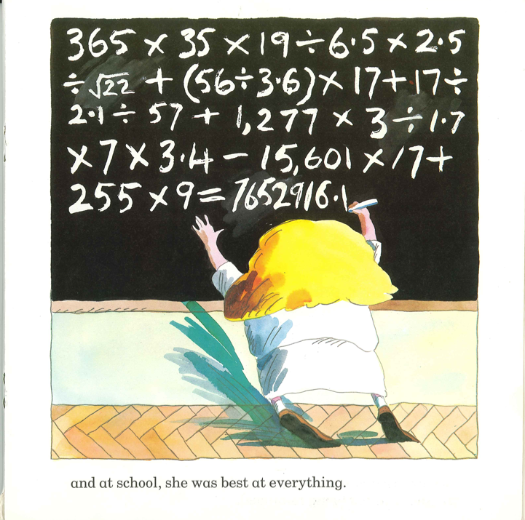

Slide 14
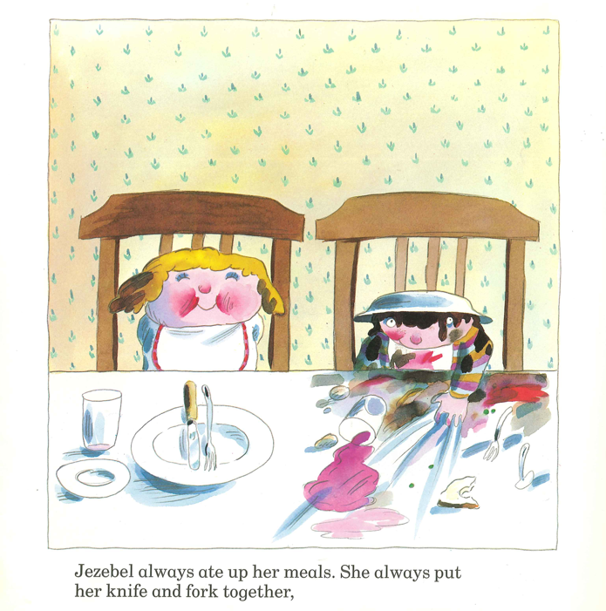

Slide 15
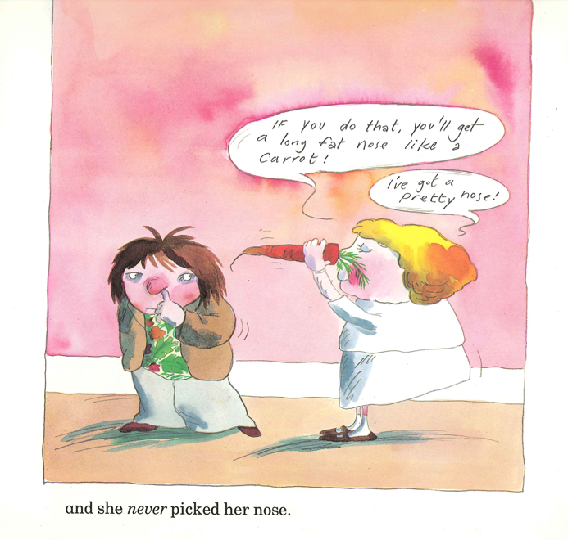

Slide 16
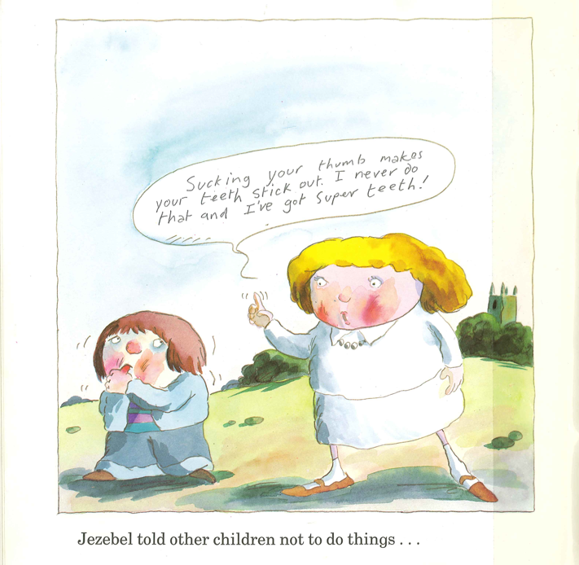

Slide 17
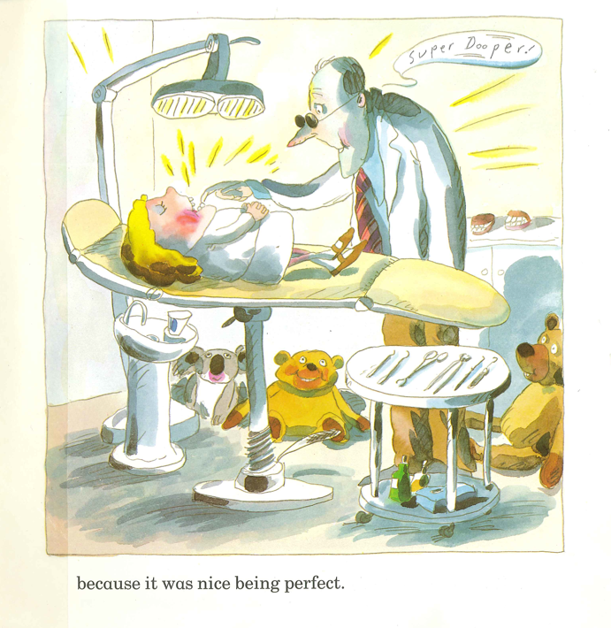

Slide 18
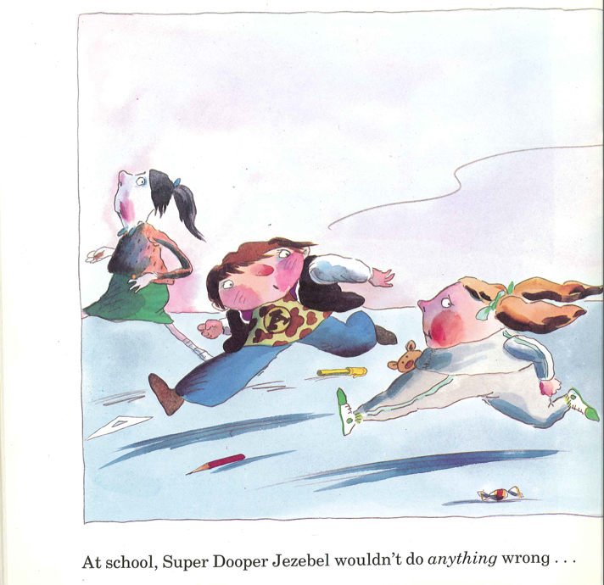

Slide 19
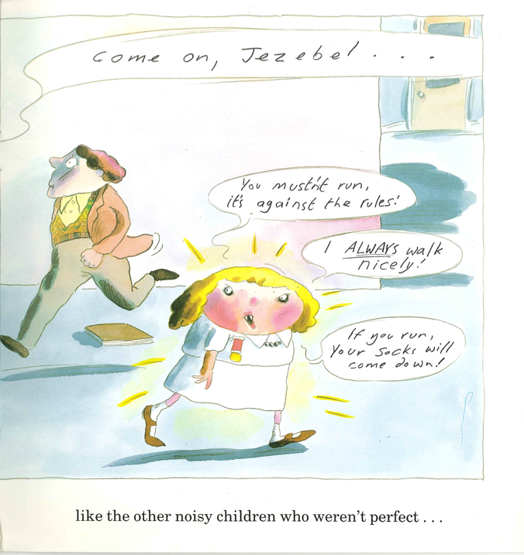

Slide 20
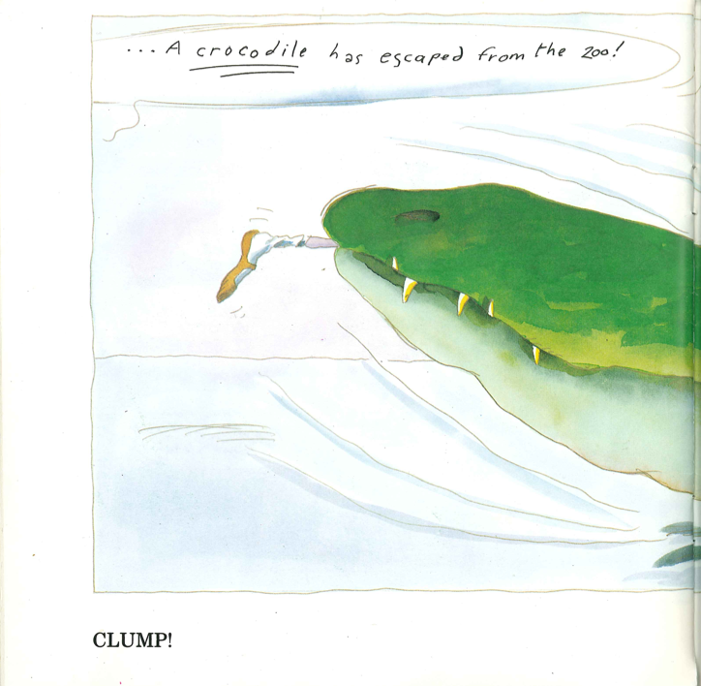
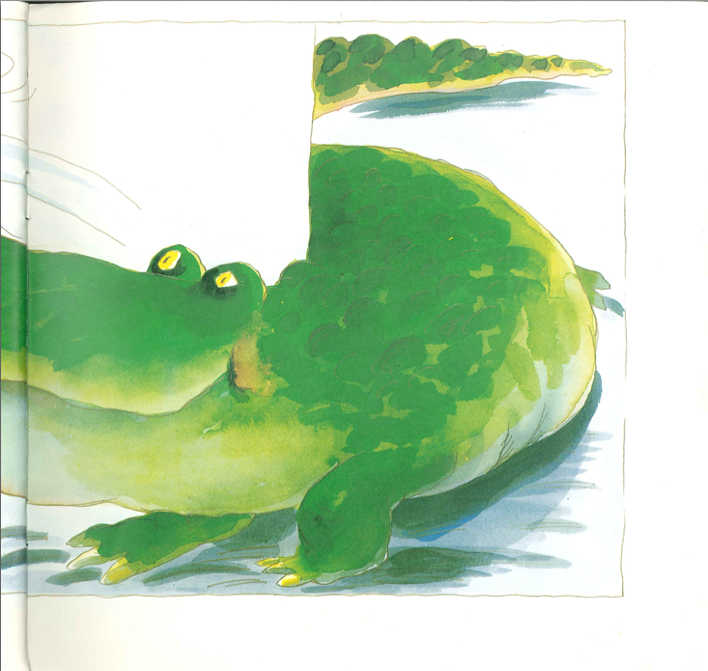

Slide 21
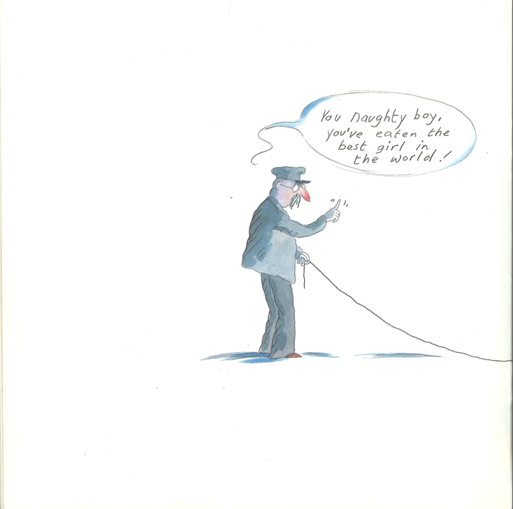

Slide 22
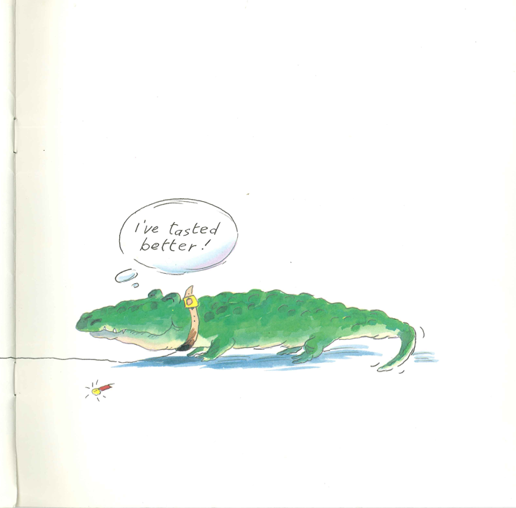

Slide 24
Genuine Partnership

Slide 25
Notes:
Been to lots of conferences where they wheel out the sooper dooper head of the sooper dooper school
Genuflect, worship …
Methodology and best practice
Us – 1400 students, upper school, KS3 feels out of our control
Ks4 – 5+EM = around 60% but should be higher – and it is for different cohorts

Slide 26
The “C” Word

Slide 27
The Restless School
Notes:
Roy Blatchford

Slide 28
Notes:
Not about the finger-wagging SDJ

Slide 29
☑

Slide 30
1: Us
Notes:
Shameful nature of national challenge
This – is about us, showt hat we’re restless for a better school, but that schools are schools not exam factories, that our best teachers – eg of English and Maths – do things that are funny, unexpected, wacky and memorable …

Slide 31
2: What teachers do

Slide 32
3: What students tell us

Slide 33
4: Quick hits & strategy

Slide 34
5: Leadership

Slide 35
5
Us
What teachers do
What students tell us
Quick hits and strategy
Leadership

Slide 36
1: Us
Schools (etc) differ
I don’t want to be head of an exam factory
Some things work sometimes …
I’ve passed my exams
5C+EM has changed everything
Notes:
JWB: School is where the children go to watch the teachers working

Slide 37
2: What teachers do
Recreating, not cloning, good teachers
Micro-skills of teaching & basics
‘Rare cover’ helps
Everyone’s responsibility
Time to turn fewer blind eyes
“What if …?”
Notes:
What would we have to do to get every student a C?

Slide 38
3: What students say
Bill Clinton was right
Swedish style interventions
Illuminate sticking-points
Be intolerant of mediocrity
Mentoring comes in different colours
Best teachers may not be teachers
Debunk brain-power myth

Slide 39
4: Quick hits & strategy
Beware the imported wacky wheeze
Language seems to be a key ingredient
D to C may be easier than we think
One single, simple strategy:
Get more good teachers teaching well in our classrooms

Slide 40
5: Leadership
Leadership is hands-on and tough
Role of Heads of English & Maths has changed
Key strategic players
It’s “and” not “or”
“Would I be happy for my child ..?”
Coach, book monitor, agitator, moaner, bluffer, student’s ally, key player in the school team

Slide 41
5
Us
What teachers do
What students tell us
Quick hits and strategy
Leadership

Slide 42
Today

Slide 43
What
How

Slide 44
Over to us

Slide 45
Creating & Promoting Excellence through Middle Leadership
Geoff Barton
King Edward VI School, Suffolk
Download this presentation at www.geoffbarton.co.uk

